Slide 1



Prepared for: Thesis Defense Committee Department of Computer Science and Engineering
IUBAT–INTERNATIONAL UNIVERSITY OF BUSINESS AGRICULTURE AND TECHNOLOGY
Founded 1991 by Md. Alimullah Miyan
Breast tumourDetection Using deep Learning
Course Code: CSC 488 (Thesis)
Supervised by:
Drs Ferdaus Anam Jibon
Associate Professor
Department of Computer
Science and Engineering, IUBAT
Prepared by:
Type_Student1_Name :Maisha Tabassum ID:22203
Type_Student1_Name : Shuvo Chakrobortty ID:22203229
Department of Computer
Science and Engineering
Date:

Slide 2

Contents
Introduction
Literature Review
Research Methodology
Work Plan
Conclusion
References
2

Slide 3
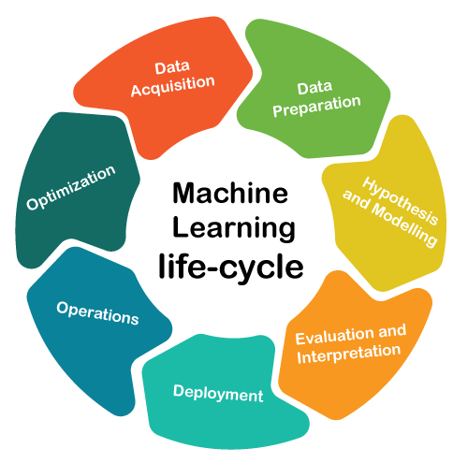
Introduction
Breast cancer is one of the most common cancers among women worldwide.
Deep learning, especially convolutional neural networks (CNNs), is revolutionizing medical image analysis.
The project focuses on automatic breast tumour detection using DL from mammography or ultrasound images
Place Thesis Proposal Title Here
3

Slide 4
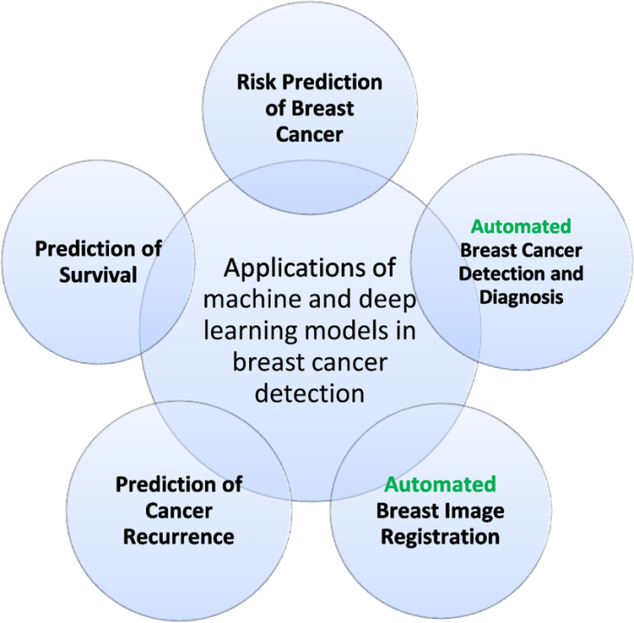
Application and Challenges
Applications:
Early breast cancer detection in clinical diagnostics
Automated screening in remote or low-resource settings
Assisting radiologists with decision support systems
Challenges:
Limited and imbalanced datasets
Noise and low-quality medical images
Overfitting and generalization of DL models
Explainability and trust in AI decisions
Place Thesis Proposal Title Here
4

Slide 5
Motivation of Research
To contribute to healthcare using AI
To solve practical issues in early detection
Intellectual curiosity in ML applications in medicine
Personal motivation to help fight cancer
Gain research expertise in machine learning and medical AI
Place Thesis Proposal Title Here
5

Slide 6
Problem Statement
Current diagnosis techniques are manual and time-consuming
High false-positive and false-negative rates in traditional detection
Need for an automated, reliable, and efficient diagnostic system
Lack of integration between image features and predictive algorithms
Place Thesis Proposal Title Here
6

Slide 7
Objectives
To develop a machine learning model to classify breast tumors (benign/malignant)
To preprocess and balance breast cancer datasets (e.g., Wisconsin Diagnostic)
To compare different ML algorithms (e.g., SVM, Random Forest, CNN)
To evaluate model performance using accuracy, precision, recall, and F1-score
Place Thesis Proposal Title Here
7

Slide 8
Literature Review-1
Paper Title: "Breast Cancer Classification Using CNN – 2020" Key Points:
Used CNN on mammogram images
Preprocessing with normalization and augmentation
Achieved ~90% accuracy Limitations:
Dataset was small
No external validation
No explainability of predictions
Place Thesis Proposal Title Here
8

Slide 9
Literature Review-2
Paper Title: "SVM and KNN-based Detection of Breast Cancer – 2021" Key Points:
Used SVM and KNN on tabular data (e.g., WBCD)
Feature selection techniques improved accuracy Limitations:
Lack of deep learning comparison
Only structured data, not image-based
Dataset imbalance not addressed properly
Place Thesis Proposal Title Here
9

Slide 10
Research Methodology
Dataset: Wisconsin Diagnostic Breast Cancer (WDBC)
Preprocessing: Normalization, outlier removal, balancing
Models: SVM, Random Forest, CNN
Evaluation: Train-test split, cross-validation, metrics comparison
Tools: Python, Scikit-learn, TensorFlow/Keras
Place Thesis Proposal Title Here
10

Slide 11
Proposed System Architecture
Place here the proposed system architecture
Place Thesis Proposal Title Here
11

Slide 12
System Requirements
Place here the proposed system requirements (if any)
Place Thesis Proposal Title Here
12

Slide 13
Flow Chart of Proposed System
Place your proposed work flowchart over here
Place Thesis Proposal Title Here
13

Slide 14
Work Plan
List the remaining work points of your thesis that you will do after this proposal presentation
Place Thesis Proposal Title Here
14

Slide 15
Conclusion
List the key points of your thesis proposal presentation
Place Thesis Proposal Title Here
15

Slide 16
References
List here the reference list by following the Harvard referencing format (Remove this line)
Nasir, A.Y., Bature, U.I., Tahir, N.M., Babawuro, A.Y., Boniface, A. and Hassan, A.M., 2020. Arduino based gas leakage control and temperature monitoring system. International Journal of Information and Communication Technology (IJ-ICT), 9(3), pp.171-178.
Qasim, H.H., Hamza, A.E., Ibrahim, H.H., Saeed, H.A. and Hamzah, M.I., 2020. Design and implementation home security system and monitoring by using wireless sensor networks WSN/internet of things IOT. International Journal of Electrical and Computer Engineering, 10(3), p.2617.
Saxena, A. and Pal, R., 2020. IoT Based Security and Controlled Smart Home Automation System Using GSM. International Journal of Research in Engineering, Science and Management, 3(8), pp.445-448.
16

Slide 17
Any Questions ?

Slide 18
Thank You

